Slide 1
DATA 606 Capstone Project
Part 1a ~ by Carlotta Amaduzzi camaduz1@umbc.edu
as of March 6, 2022

Slide 2

Overview
Access to Higher Education is essential
to maintain a more equitable society
to inspire individual professional and financial growth
to ensure social mobility
Understanding the factors that influence undergraduate enrollment in Higher Education Institutions (HEIs) can have a double positive effect:
on the HEIs themselves which are for all practical purposes fairly large (business) organizations
on the impact increased levels of education can have on society as a whole

Slide 3

Research Focus
The questions I am interested in looking into are the following:
Based on publicly reported information regarding HEIs, what features seem to affect student enrollment choice the most?
With an eye to I.D.E.A. (Inclusion, Diversity, Equity, and Access), do HEIs with different structural characteristics, fare differently across the US?
Are new policies adopted by HEIs, such as standardized-tests-blind admission policies, having an effect on students’ enrollment?

Slide 4
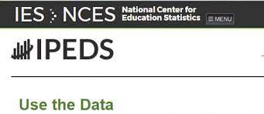
The Data
The data initially used for this project is all publicly available information
The data was downloaded from the Integrated Postsecondary Education Data System (IPEDS) web site (https://nces.ed.gov/ipeds/datacenter/DataFiles.aspx )
It refers to different files of data relative to HEIs
Institutional ID data
Institutions Offerings
Students’ Enrollment data
Admissions’ Policies
Focus was placed exclusively on data directly reported by the HEIs themselves

Slide 5

Data Cleaning
During this initial phase of data cleaning primary focus has been placed on acquiring a sound sub-set of HEIs for which up-to-date data was available for the 2019-2020 academic year.
Dictionary files accompanying each datafile have been extensively used to identify the salient features retained for the analysis and to understand the reported data
The short-list of institutions selected will be used to complete a comparative analysis across time, if possible

Slide 6

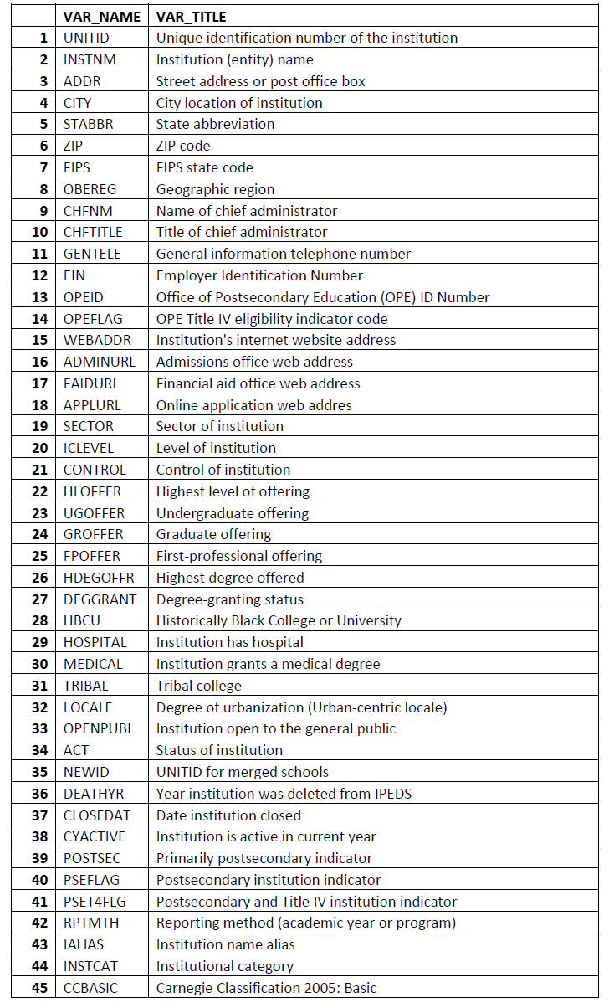
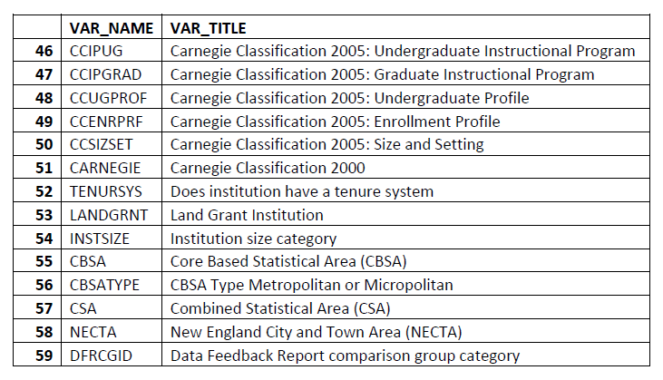
Institutional Descriptive data
Data File: hd2020.csv
Dictionary: hd2020.xls
The data file contains 59 different variables that help unequivocally identify each HEI

Slide 7
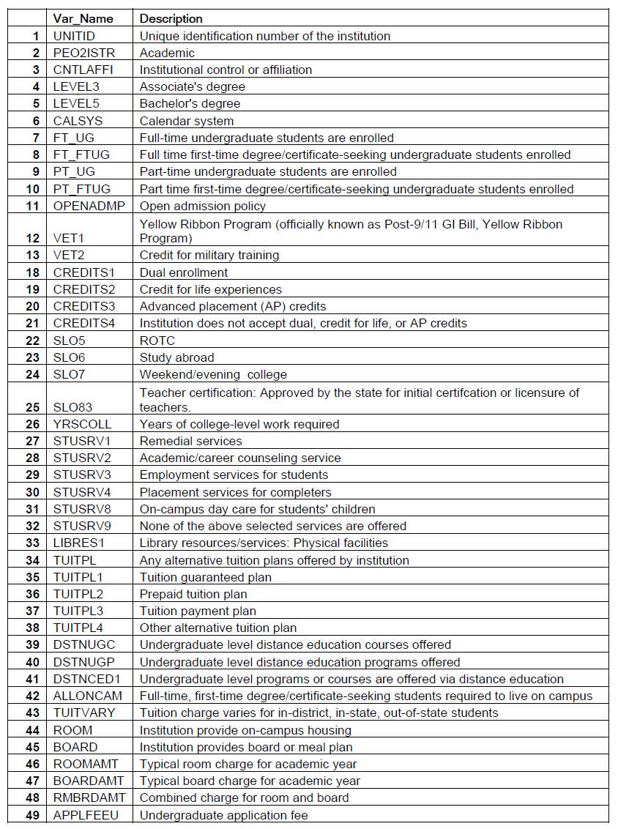
Services Offered Descriptive data
Data File: ic2020.csv
Dictionary: ic2020.xls
The data file contains 49 different variables that offer information regarding HEIs services offerings

Slide 8
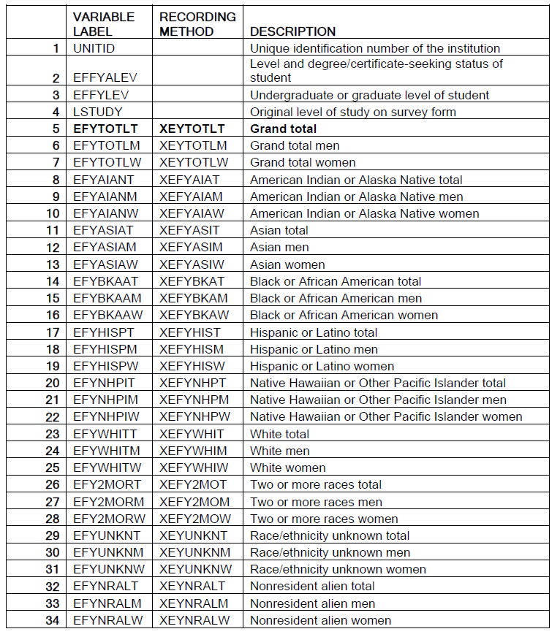
Student Enrollment data
Data File: effy2020.csv
Dictionary: effy2020.xls
The data file contains 34 different variables that offer information regarding HEIs students (not including 30 Imputation Variables)

Slide 9
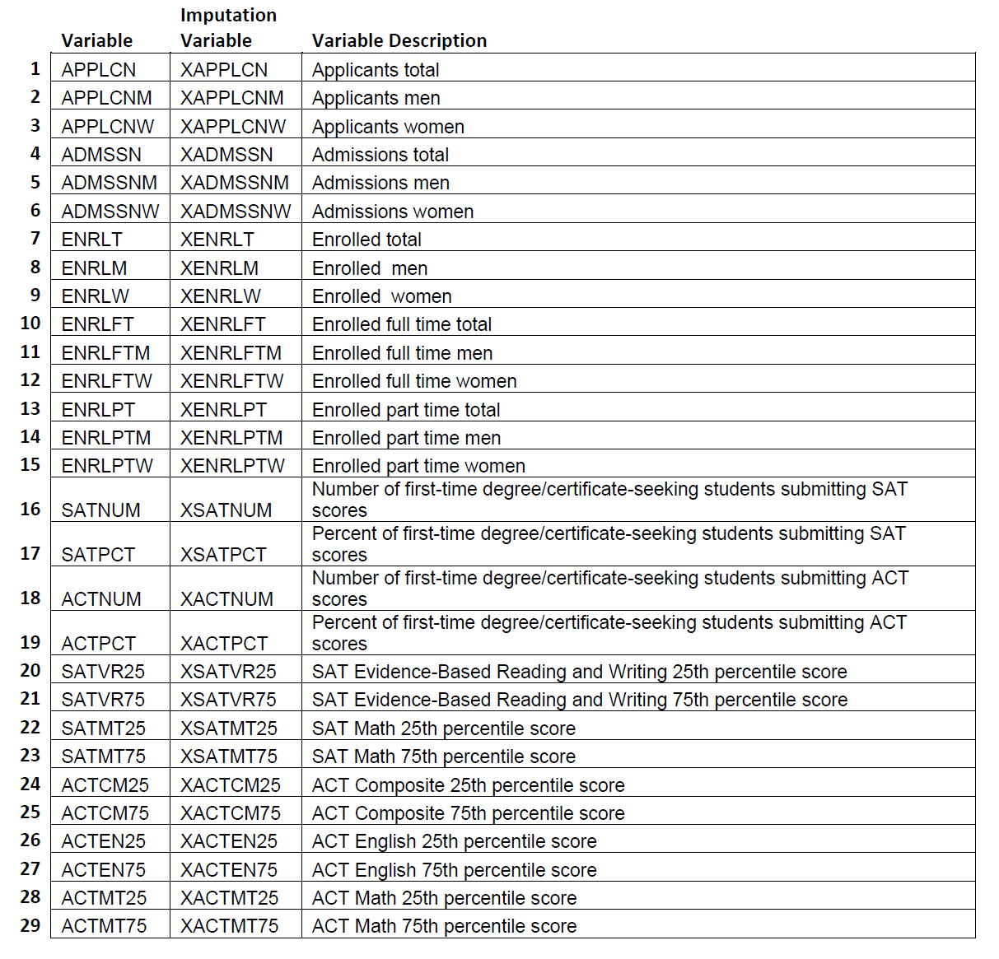
Institutions’ Admin data
Data File: adm2020.csv
Dictionary: adm2020.xls
The data file contains 29 different variables that offer information regarding HEIs enrollment policies (not including 29 Imputation Variables)
NOTE: All the data included in this Table refers to Institutions without Open Enrollment Policies in place (ie Institutions that do not automatically admit any candidate)

Slide 10
Current Status of the data
The files have been merged and the data cleansed
The institutions shortlisted are over 3500
The data refers to 59 US States & Territories
The current data refers only to 2019-2020
65 Variables are currently still being examined
Let’s take a look at some initial exploratory analysis of this data…
(for more information please refer to the accompanying notebook)

Slide 11
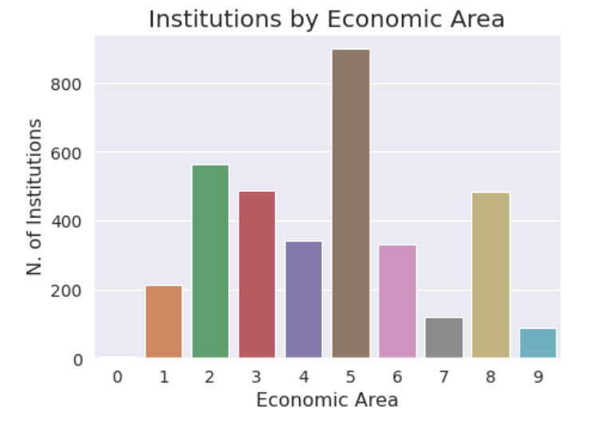
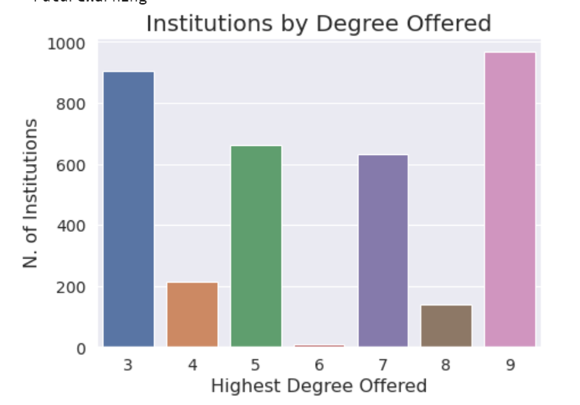
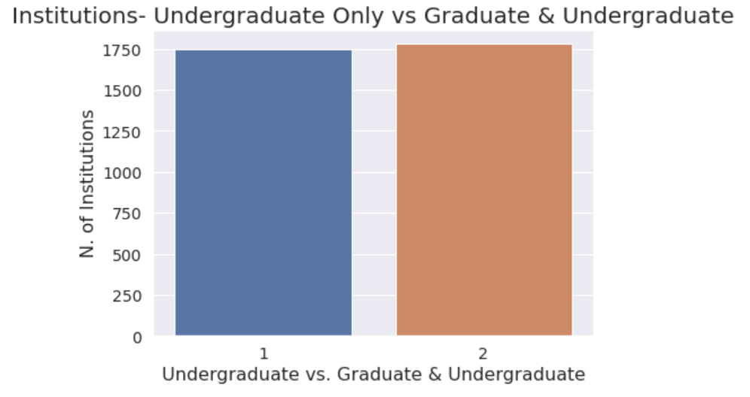
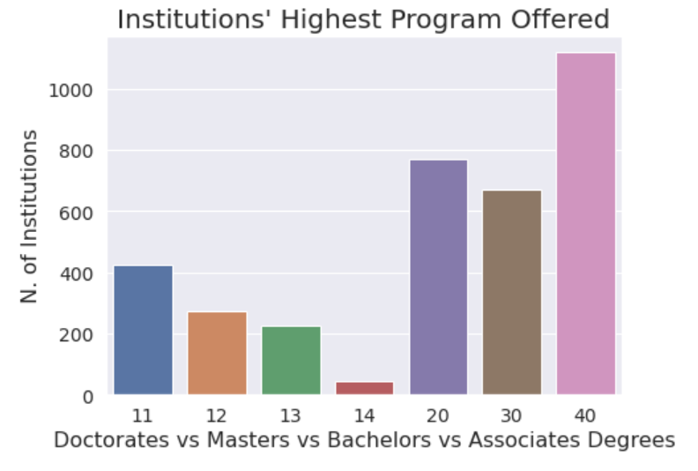
The data count is fairly unbalanced for most of the features
There may be redundancy of information captured by a couple of the variables (for example HEIs count by Highest Degree Offered vs by Highest Program Offered vs by Degree Granting Status (on the next slide)

Slide 12
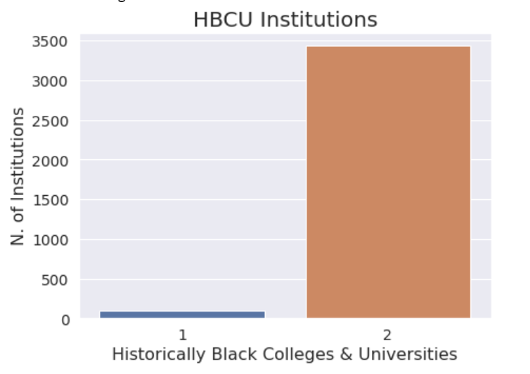
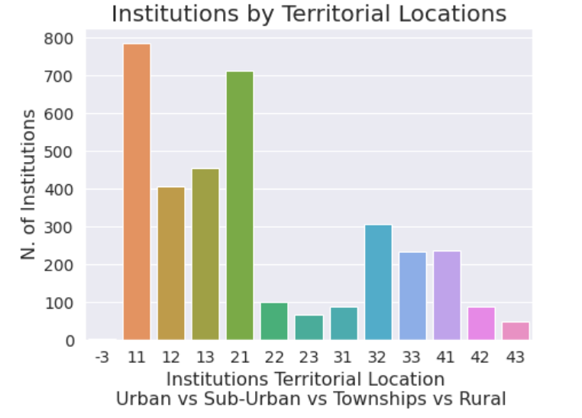
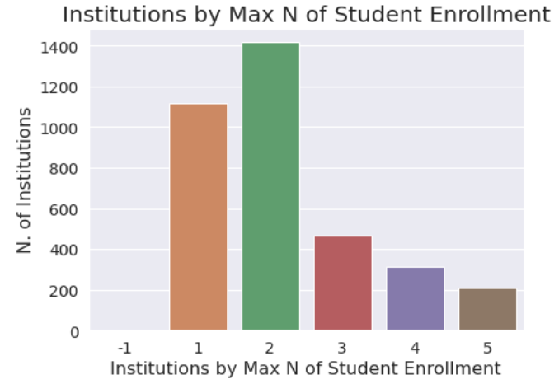
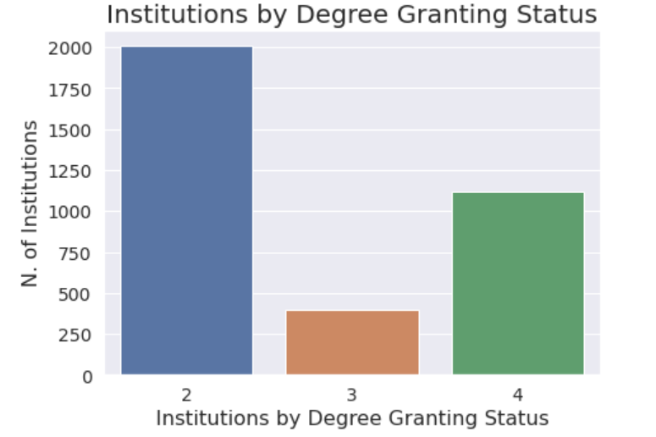
HBCU HEIs are a minority
HEIs are concentrated in Urban areas
Most of the HEIs are smaller in size (admitting up to 5000 Students per year – codes 1&2)
HEIs offering lower level degrees compose the majority of our data (NOTE: There is however overlap between many HEIs offering Graduate level degrees and Undergraduate level degrees)

Slide 13
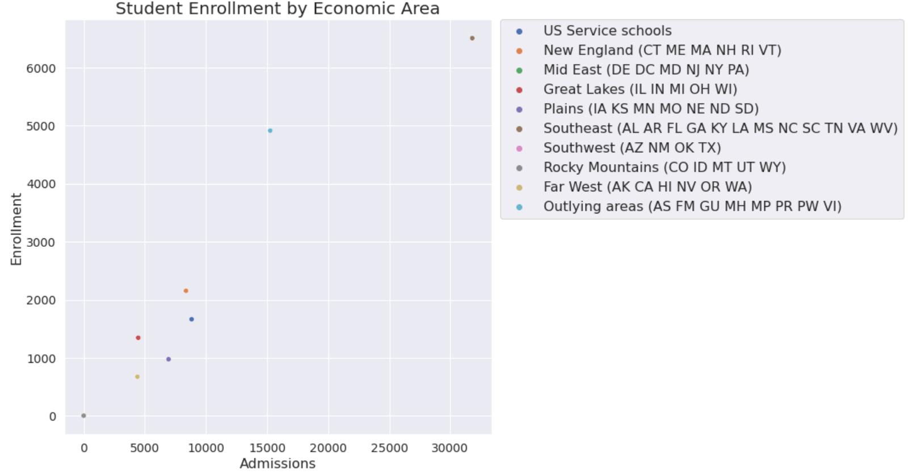
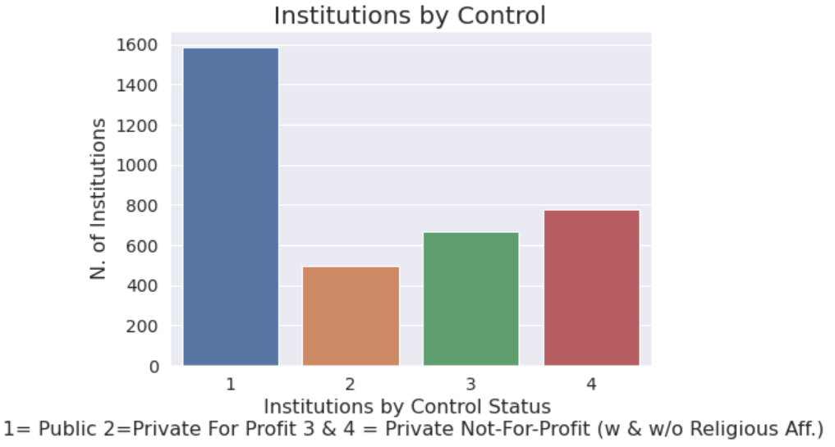
Admissions Vs Enrollment are obviously Positively correlated
HEIs located in our area have high rates of admissions and Enrollments
HEIs in the West are likely to be smaller in size in spite of being more numerous
Aggregately Private vs Public Institutions form two relatively balanced groups (NOTE: Disaggregating Private organizations by For Profit vs Not shows a different picture)

Slide 14
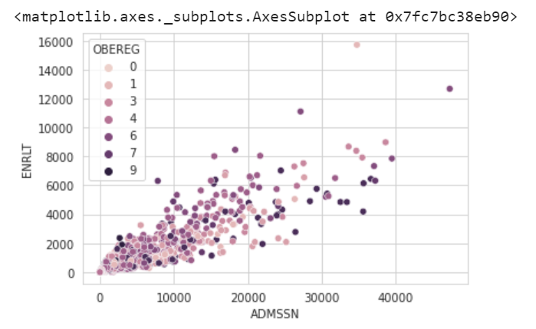
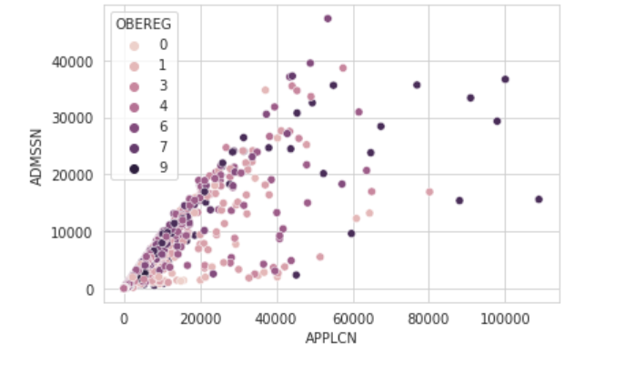
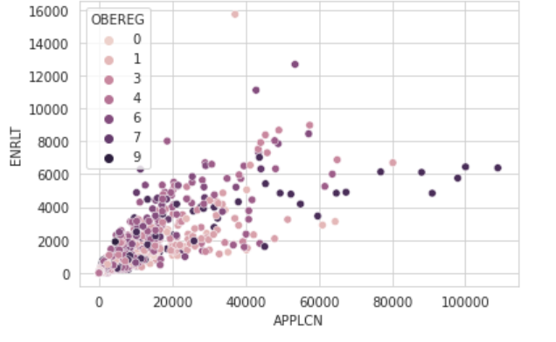
More as an academic exercise, checking n. of Enrollments versus Admissions and Applications (separately), highlights a clear correlation between the data As does n of Applications vs. Admissions, to a lesser extent

Slide 15
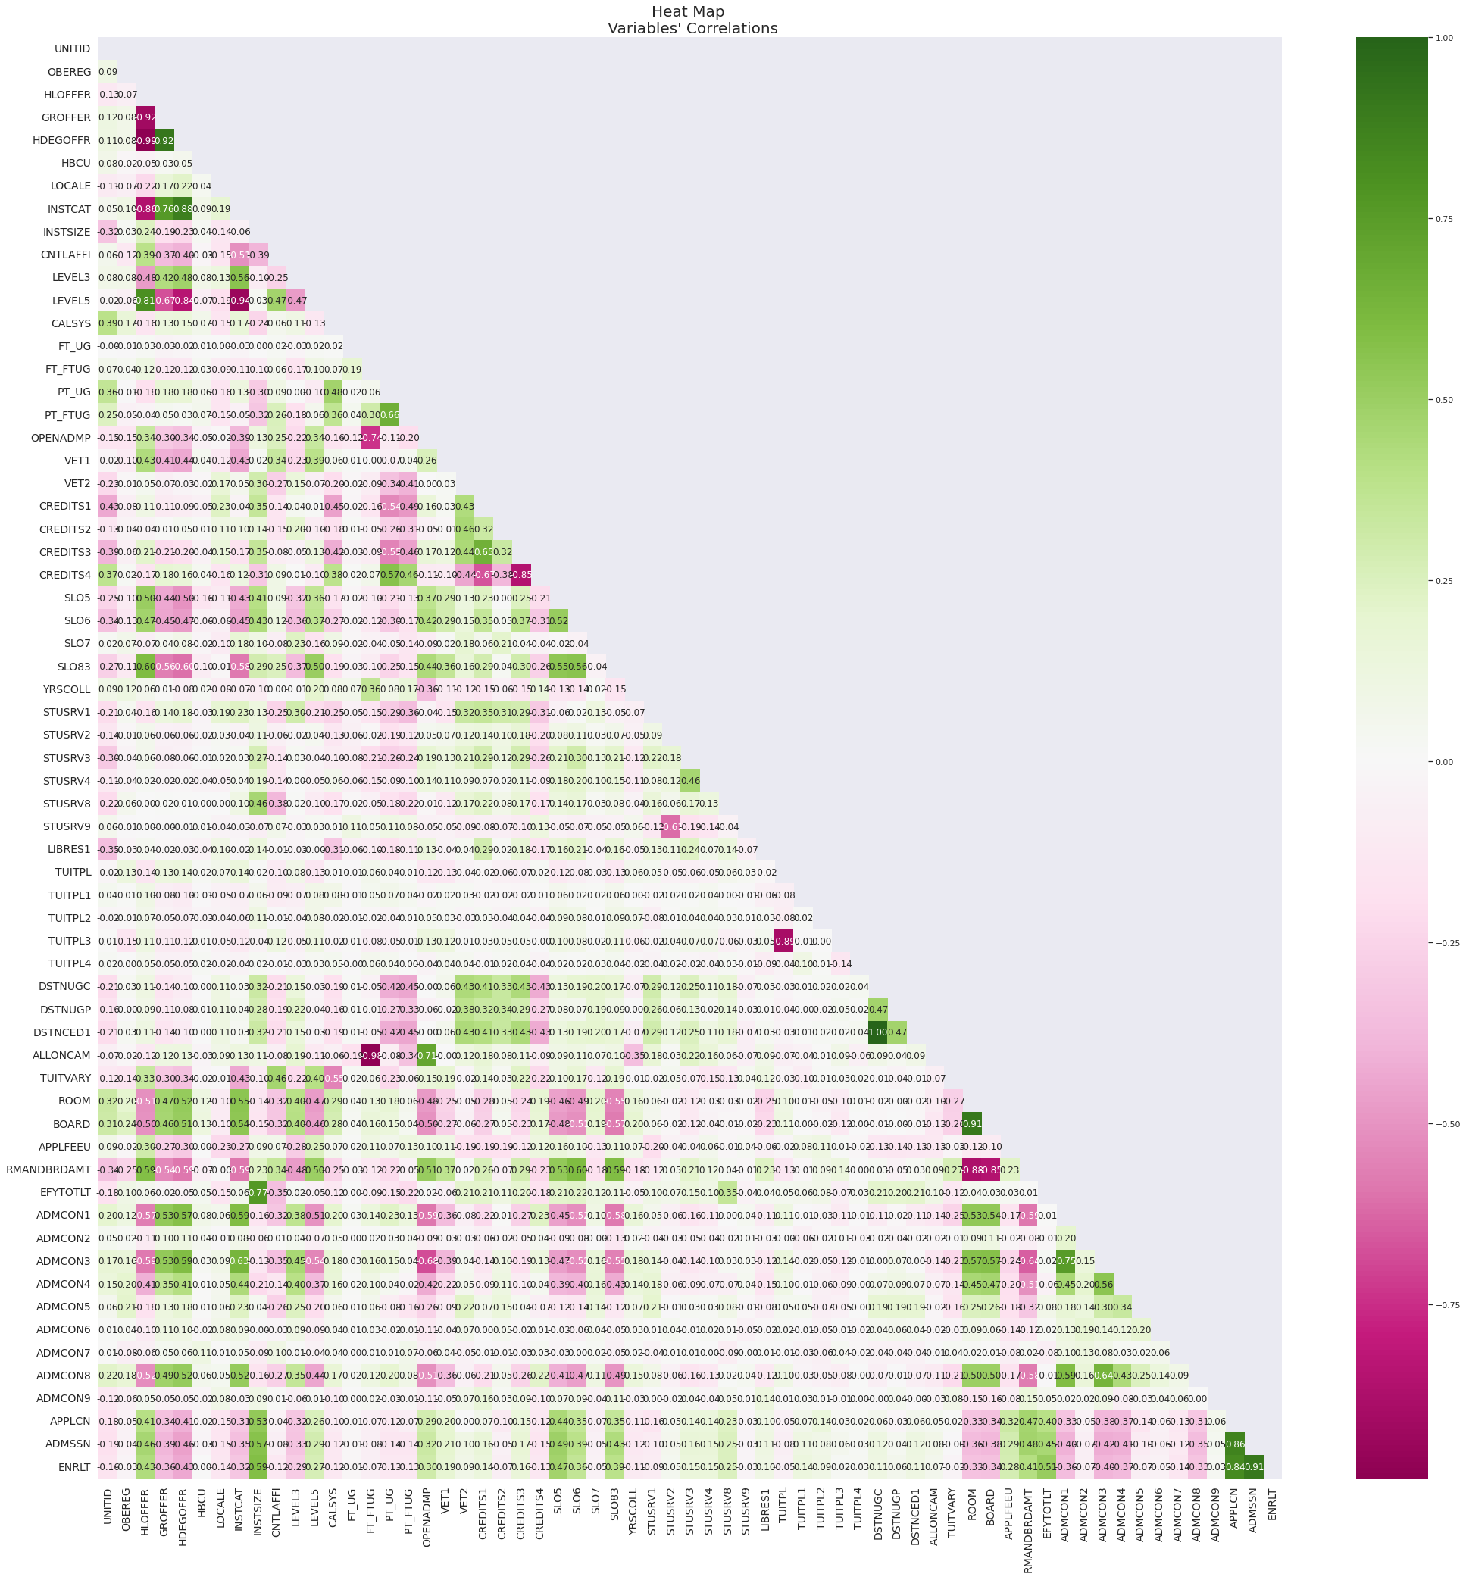
Checking the Correlation heatmap the greatest correlation with Application, Admission, and Enrollment total numbers appear to be with the following variables:
HLOFFER, GROFFER, HDEOFFER , LEVEL3 & LEVEL5 & INSTCAT– Vars associated with level of degrees offered
INSTSIZE – Vars pertaining to the size of the Institutions
OPENADMP – HEIs Open Admissions Policy
SLO5 – Var indicating ROTC program
SLO6 – Var indicating Study Abroad Programs
SLO83 – Var indicating Teacher Certification Programs
ROOM, BOARD, APPLEFEE – Costs associated with Room, Board, and Applications
ADMCON1 – Var indicating HS GPAs
ADMCON3 – Var indicating School Records
ADMCON4 –Completion of College Prep Programs
ADMCON8 – Var indicating TOEFL Scores
Interestingly at first glance Tuition Plans do not seem to have as large an effect on Enrollment decisions

Slide 16
Intended next steps
- Verifying data scales & Normalizing data to
- Completing data cleaning (possibly eliminating outlier data)
- Separating out a Test set to avoid increasing the models’ bias down the road
- Continue with some additional data visualizations & Initial Exploratory Analysis
- Selecting the best ML models (Regression Model; possibly DBSCAN for clustering; Feature Selection optimization via Principal Component Analysis)
-Extracting the shortlisted Institutions’ data across different years

